Slide 1
FINAL PROJECT CIT COURSE
MS OFFICE,WORD EXCEL POWERPOINT RESUME CREATION,DATA ENTRY

Slide 2
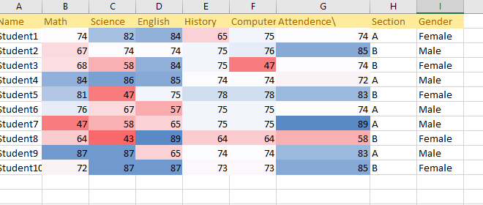
It allows users to enter information into rows and columns, making it easier to read, sort, and analyze. With the help of formulas and functions, Excel can perform automatic calculations like totals, averages, and percentages, which saves time and reduces errors. Spreadsheets are also used to create charts and graphs, helping to visualize data for better understanding and decision-making. Whether it’s for budgeting, attendance, inventory, marksheets, or professional reports, Excel spreadsheets help keep records neat, accurate,
and easy to update.
SPREED SHEET IN EXCEL

Slide 3
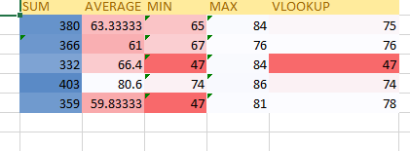
quick and accurate calculations. SUM is used to add a range of numbers, which is helpful
for calculating totals like expenses or marks. AVERAGE finds the mean value of selected numbers, often used to calculate average scores or prices. MIN and MAX help identify the smallest and largest values in a data set, which is useful for comparing results or finding extremes. VLOOKUP is a powerful function used to search for a value in one column and return related information from another column, making it ideal for looking up student records, prices, or any matching data. These functions save time, reduce errors, and help in
analyzing large amounts of data efficiently.
SUM,AVERAGE,MIN,MAX,VLOOKUP IN EXCEL

Slide 4
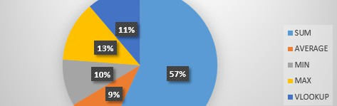
CHART OF SPREEDSHEET IN EXCEL
Charts in Excel spreadsheets are used to visually represent data, making it easier to understand and analyze. Instead of just looking at numbers in rows and columns, charts help show trends, comparisons, and patterns clearly. For example, a bar chart can compare sales of different products, a line chart can show growth over time, and a pie chart can display how different parts contribute to a whole. Using charts makes reports more attractive and meaningful, especially for presentations and decision-making. They help users quickly grasp complex information and make data-driven conclusions.

Slide 5
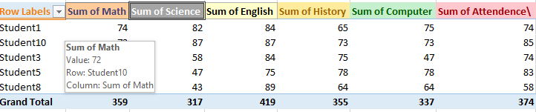
PIVOTTABLE IN EXCEL
A Pivot Table in Excel is used to quickly summarize, analyze, and organize large amounts of data. It allows users to extract important information by rearranging (or "pivoting") rows and columns without changing the original data. With a Pivot Table,
you can easily calculate totals, averages, counts, and percentages, and group data by categories such as dates,
department
s, or products. This makes it especially useful for business reports, financial analysis, and data comparison. Pivot Tables save time and help users make smart decisions by turning complex data into clear and meaningful summaries.

Slide 6
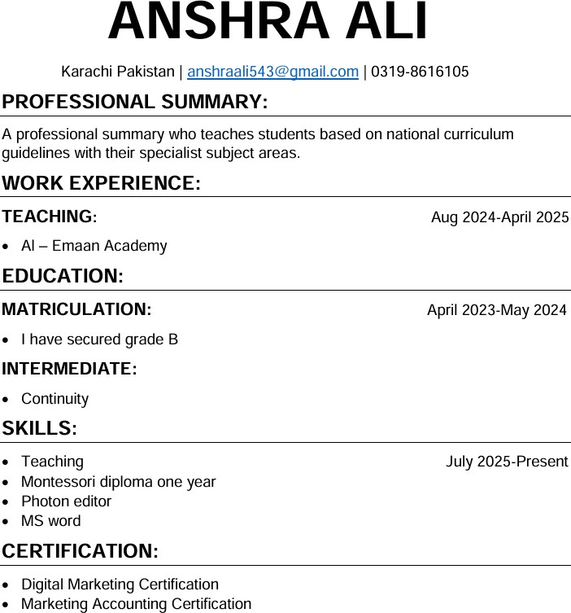
To create a resume in MS Word, you can use the built-in Resume Templates to make the process quick and professional. Start by opening MS Word, click on "File", then "New", and search for “Resume” in the search bar. Choose a template that
RESUME
suits
Experience, Skills, and References. Use formatting options such as bold, italics, font size, and bullet points to make your
your style and click "Create". Now, you can edit the sections like Name, Contact Information, Objective, Education, Work
resume neat and easy to read. You can also insert lines, icons, or tables if needed. Once done, save your file in PDF format
for easy sharing.

